Slide 1
Unlocking Strategic Insights: Leveraging Data Analysis for Business Growth
Understanding Business Challenges and Crafting Solutions
By priyanka pachkawade

Slide 2
content
Introduction
Problem statement
Insights
Solution Proposal
Conclusion

Slide 3
introduction
Introduction to the Business or Industry. Analysis focuses on
Business growth
Sales and Revenue
Market Effectiveness
Customer Behavior
Financial Performance
Product Development

Slide 4
Problem statement
The Growth team seeks to understand which product categories drive sustainable profits.
Sustainability is crucial for long-term success, and profitability serves as a key indicator.

Slide 5
category wise profit.

Slide 6
insights
We can see in above slide there is three category Office Supplies , Technology and Furniture.
Here technology is a high profitable category then office supplies and furniture is the lowest profit category among them.
So company can shut down Furniture category.

Slide 7
Product Subcategory Wise Profit

Slide 8
insights
Knowing which products make the most money helps the company decide where to focus resources , adjust prices , and manage inventory better for long-term profits.
In above slide we can see the many subcategory .
But in that Rubber band ,Bookcases, Tables and Scissors , rulers and trimmers these subcategories profit in minus .so company can shut down these subcategories .

Slide 9
Product Wise Profit

Slide 10
insights
Knowing which products make the most money helps the company decide where to focus resources , adjust prices , and manage inventory better for long-term profits.
In above slide we found product wise profit and got some meaning full insights like prod_17,prod_4, prod_3 are the highest profitable product .
prod_12, prod_13, prod_1, prod_7 these products produce low profit
prod_16 , prod_10, prod_11 these products are in loss ,they are not profitable.
So company can shut down these products which in produce a low profit .

Slide 11
Profitable product category and subcategory after removing loss product

Slide 12
insights
In above slide we see the all profitable product category and subcategory after removing loss products .
This helps to company knowing which products make money helps the company focus on what’s working ,make smarter decision ,and stay ahead of the competition.

Slide 13
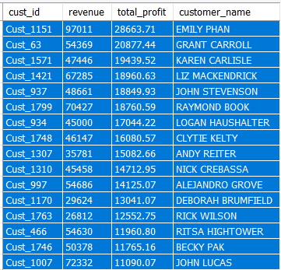
Which customers are most profitable and generate most revenue?

Slide 14
insights
Identifying the most profitable and revenue-generating customers allows the company to focus resources and tailor strategies to retain and expand these relationships, potentially through loyalty programs or personalized offerings.
Insights gained include understanding customer preferences, behaviors, and demographics, enabling targeted marketing efforts, product development, and customer service enhancements to maximize overall profitability.
When analyzing customer profitability and revenue generation, the 80/20 rule suggests that approximately 80% of a company's revenue is derived from around 20% of its customers. By identifying these high-value customers through analysis, companies gain insights that can drive strategic decisions.

Slide 15
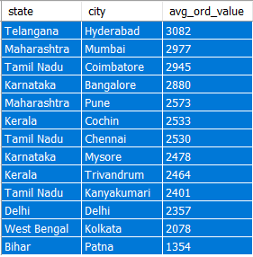
Average order value per city/ state

Slide 16
insights
Analyzing average order value per city/state helps in targeted marketing, inventory management, pricing strategies, customer segmentation, and identifying expansion opportunities, optimizing resources and driving profitability.
In above slide showing the state with city their average order value.

Slide 17
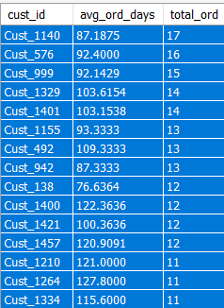
Average time for order for every customer

Slide 18
insights
Analyzing average order times per customer aids in assessing satisfaction, optimizing operations, identifying bottlenecks, personalizing service, and enhancing predictive analytics, enabling improved customer experience and operational efficiency.

Slide 19
Solution proposal
Improve Customer Satisfaction: By enhancing the customer experience through personalized marketing and streamlined processes, the company can foster greater loyalty and repeat business.
Increase Operational Efficiency: Optimization of inventory management and order processing reduces fulfillment times, leading to cost savings and improved resource utilization.
Drive Revenue Growth: Targeted customer engagement initiatives capitalize on insights from customer segmentation, boosting sales and revenue through tailored promotions.
Foster Continuous Improvement: Regular monitoring of key metrics ensures that the company can adapt and evolve its strategies over time to stay ahead of changing market dynamics.
Make Informed Decisions: Leveraging data-driven insights enables the company to anticipate customer needs and market trends, guiding strategic decision-making for sustained success.

Slide 20
conclusion
After conducting a comprehensive analysis of our data, profitability indicators, we have gained valuable insights that will drive our strategic initiatives forward. By understanding customer behavior, optimizing operational processes, and targeting high-value segments, we are poised to enhance customer satisfaction, increase operational efficiency, and drive revenue growth. With a focus on continuous improvement and data-driven decision-making, we are confident in our ability to achieve sustainable success and maintain a competitive edge in the market.

Slide 21
thankyou
.

